Slide 1
International students’ Action for Adapting Cross-Cultural activities MULTIPLIER EVENT 24.11.2022
No. 2020-1-PL01-KA203-082267
Implementation period: 01.12.2020 – 30.11.2022
Leader: WSEI University

Slide 2
About ISAAC

Slide 3
Aim of the project
The purpose of the project is to create a cooperation network and to create a model of support for international students and useful tools that will help them adapt to the new environment, in order to strengthen the international character of universities from countries less attractive to students, based on the experience of more attractive countries.
The aim of the project is to study the needs and problems of international students and create materials and guidebooks to facilitate the acclimatization of students abroad and improve cooperation with university staff.

Slide 4
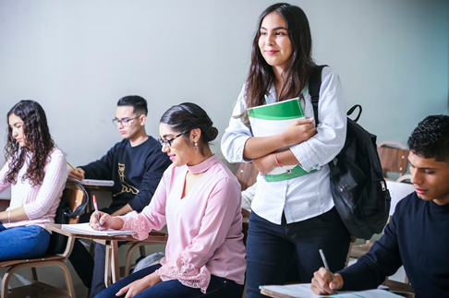
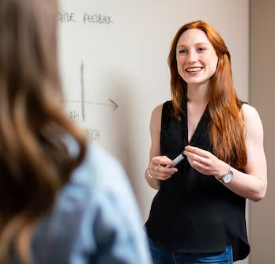
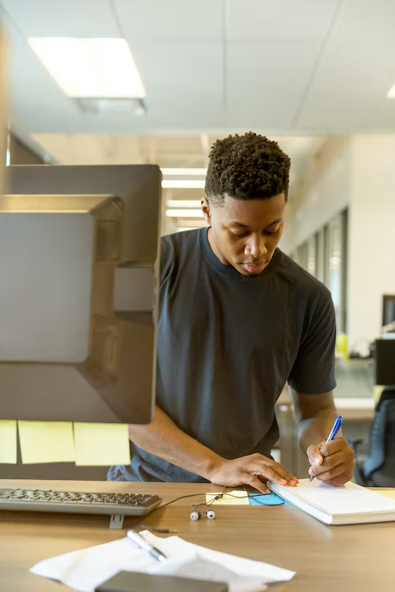
Target groups
Domestic and international students
Lecturers, educators, people leading classess
Mobility programmes coordinators at universities
University staff working with international students

Slide 5
Partners
WSEI UNIVERSITY
COFAC COOPERATIVA DE FORMACAO E ANIMACAO CULTURAL CRL
PANEPISTIMIO THESSALIAS
PROFICIO SKOPJE
FUNDACION ETEA PARA EL DESARROLLO Y LA COOPERACIÓN

Slide 6
ITS NOT ONLY THE HOT WEATHER THAT BRINGS STUDENTS IN! EUROSTAT, 2015
Students
Problems
There’s around 1.6 million of international students studied in the countries of European Union
culture shock,
language barrier,
inability to understand different non-verbal communication and social norms,
difficulties in organizing day-to-day life in a different environment.
Many psychologists state that foreign students face higher level of stress due to the relocation and diversity of the problems they have to cope with. What’s the reason for this? On the one hand foreign students complain on the lack of the assistance from the university, on the other – higher education institution staff believes that they’re doing their best to help students.
Destination countries: the United Kingdom (which was part of the EU at the time this survey was conducted), Germany, France and Spain
Why there?
The desire to settle down and find a job there after graduation.
The possibility of self-development
The location and climate of the destination country.

Slide 7
Project results

Slide 8
Rezultaty

Slide 9
ISAAC project results
Model of support for international student's adaptation
Welcome guide for foreign students
3 aspects of cross-cultural adaptation: - the perspective of the university - the perspective of domestic students - the perspective of foreign students
Welcome guide, odpowiadający na zdefiniowane w projekcie potrzeby
Guidebook for university staff working with foreign students
Interactive materials - edugraphics
"Do's and dont's," instructions how to act and behave, the so-called international "savoir vivre"
Visual representation of useful information for students and university staff

Slide 10
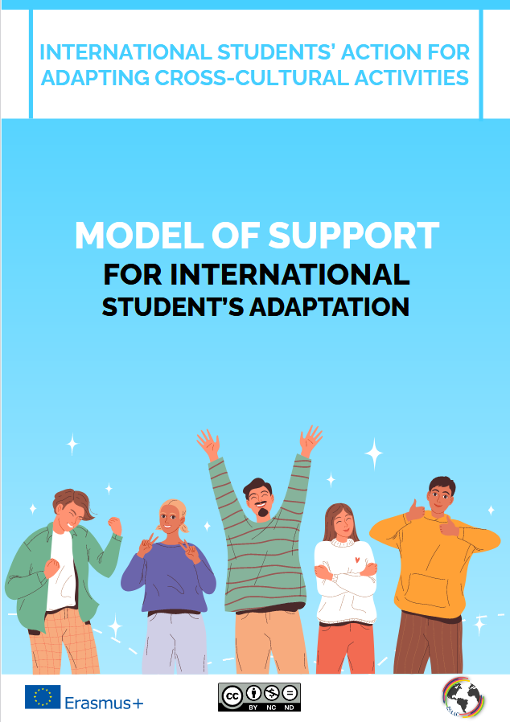
MODEL OF SUPPORT FOR INTERNATIONAL STUDENT'S ADAPTATION

Slide 11
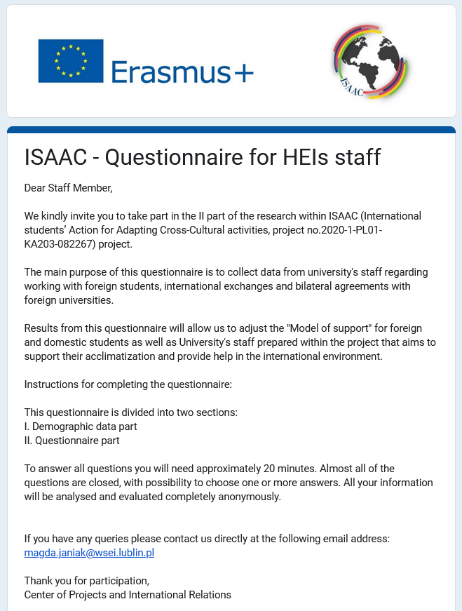
GUIDE BOOK OF "DOS AND DON'TS" FOR UNIVERSITY STAFF WORKING WITH FOREIGN STUDENTS

Slide 12
WELCOME GUIDE FOR FOREIGN STUDENTS

Slide 13
INTERACTIVE MATERIALS – EDUGRAPHICS

Slide 14
Dissemination
Social media:
Univerity
Website: www.wsei.lublin.pl
Facebook: www.facebook.com/akademiawsei
Linkedin: pl.linkedin.com/in/wyższa-szkoła-ekonomii-i-innowacji
Instagram: www.instagram.com/akademiawsei
Twitter: twitter.com/wseilublin
Youtube: www.youtube.com/wseilublin1
Project
ISAAC website: https://isaac.wsei.eu/
Facebook: ISAAC Project EU https://www.facebook.com/profile.php?id=100075085691947
FB group: ISAAC - international students' communication group
Instagram: isaac_eu_project
media
Regular meetings with students
University Events, e.g. Festival of Culters at WSEI
Conferences, workshops
Mailing
Virtual Dean’s office at WSEI and partner Universities

Slide 15
Thank you!
WSEI University
Centre of Projects and International Cooperation
4 Projektowa Street, 20-209 Lublin, Poland
+48 81 749 32 27
Artur Grzesiak – Director
Magda Janiak – Vice Director
Edyta Wiśniewska – Int. Projects Specialist
Karolina Rzechuła – Int. Projects Assistant
Eliza Wiącek Panas– Int. Projects Assistant

